Slide 1
NBA Analysis
Using machine learning techniques to predict whether a shot is made

Slide 2
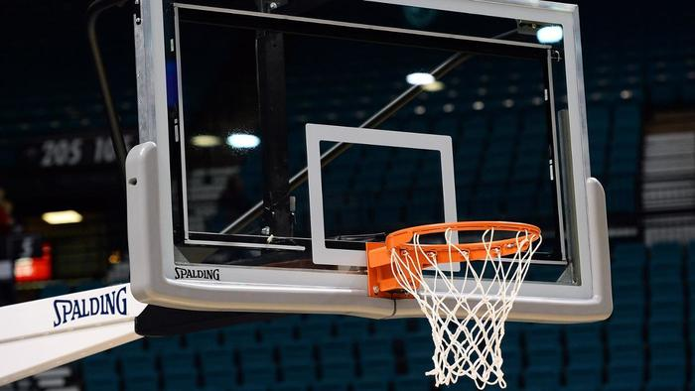
Goals
To predict to a solid level of confidence whether a shot is made
To understand what contributes to whether a shot is made

Slide 3
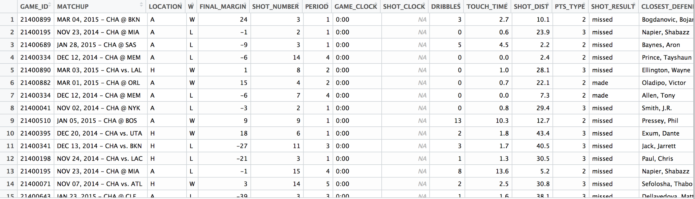
DATA
Data on shots taken during the 2014-2015 season, who took the shot, where on the floor was the shot taken from, who was the nearest defender, how far away was the nearest defender, time on the shot clock, and much more

Slide 4
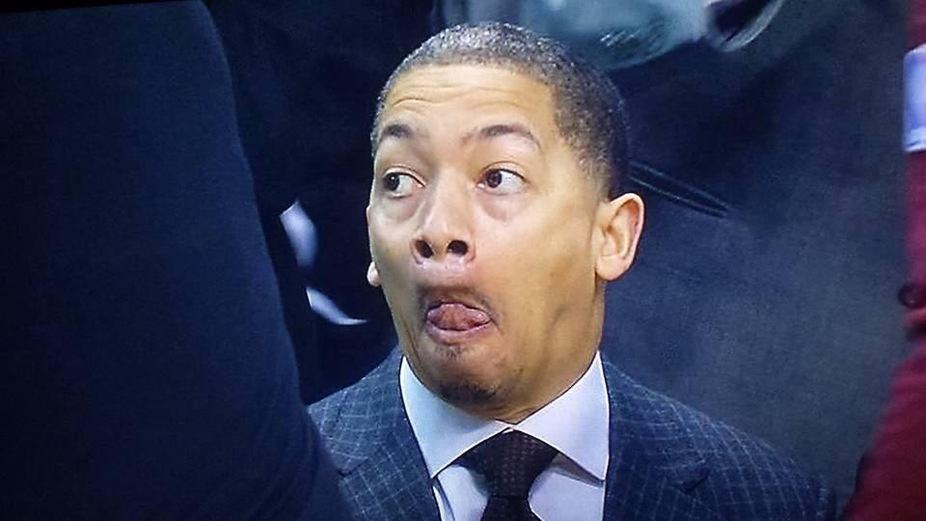
Now the problem….
The Cleveland Cavaliers are down by 2 with 9 seconds left in the game….. they need a 3 pt shot to win the game
Tyronn Lue calls a timeout
He has to make the choice on who to have shoot the ball from the inbound

Slide 5
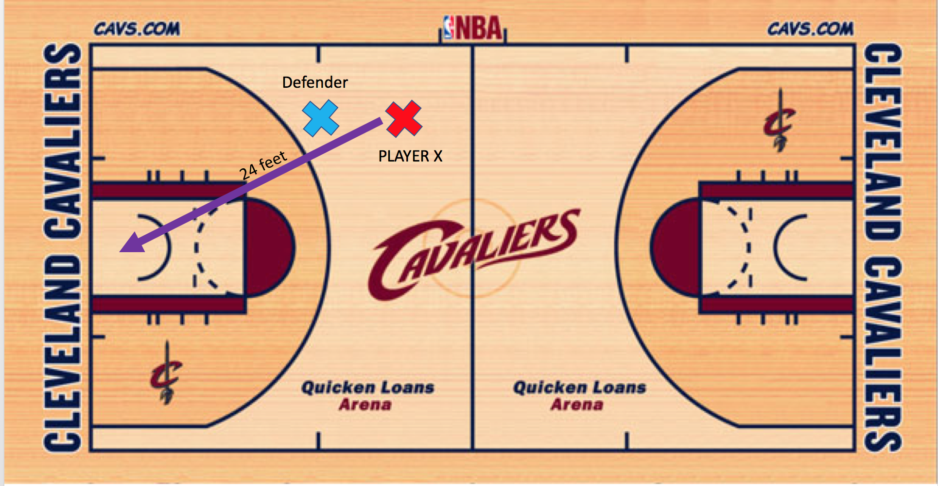
SITUATION

Slide 6
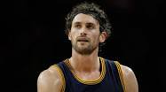
What would happen in reality?
Tyronn Lue would most likely put the ball in Lebron’s hands
I mean, Lebron is the best basketball player of our time
However, Tyronn Lue just cost the Cavs the game giving it to a player who in my models would almost never make that shot
What should happen?
The ball should go to Kyrie Irving
Kyrie Irving is the best fit to take the shot

Slide 7
Method: Machine Learning with XGBOOST
A combination of data cleaning, variable analysis, and machine learning
I produced a model for each NBA player detailing under what conditions they make shots
The models predicted upwards of 90% accuracy on the test set, and close to 100% on the training set
In other words, the xgboost model found a reasonable pattern within the data
Through the models, I tested a new data set, which detailed this very situation I described earlier
Excluded factors that would reveal to build model (like pts, fgm, …)

Slide 8
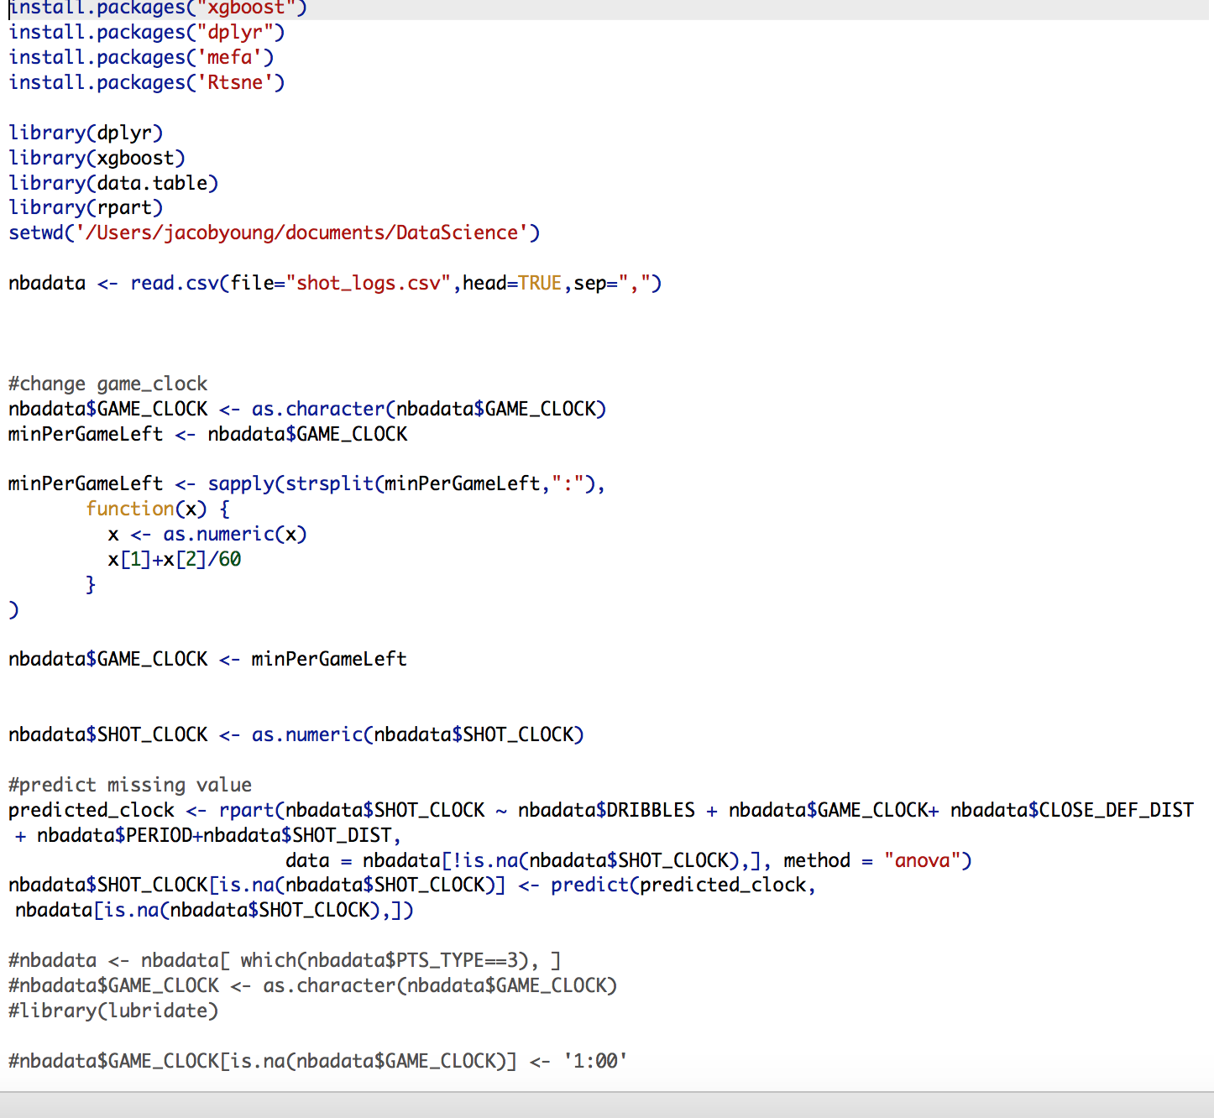
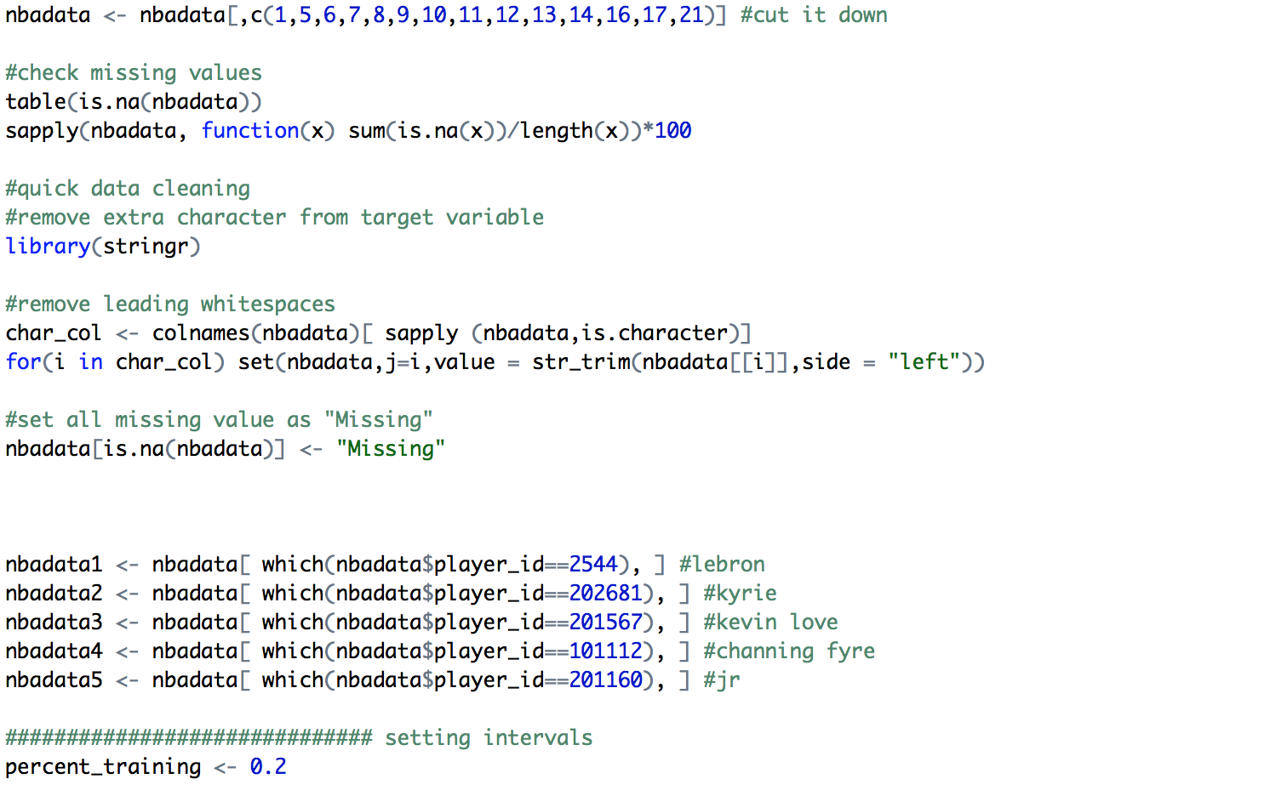
Code
Roughly 350 lines
Mostly cleaning to make fit for xgboost model

Slide 9
Results
Confidence of Model:
Lebron: 89%
Kyrie: 87%
Kevin: 93%
Channing: 97%
JR: 98%
Lebron James: 0.9448389----> missed
Kyrie Irving: 0.2600898------> made
Kevin Love: 0.8550103 ----> missed
Channing Frye: 0.4017174----> made
Jr. Smith: .0.452643----> made (barely)
Less than .5 means model predicts it to be made
0 = Made
1 = Missed
A conservative coach might choose Channing….. With a model that accurate

Slide 10
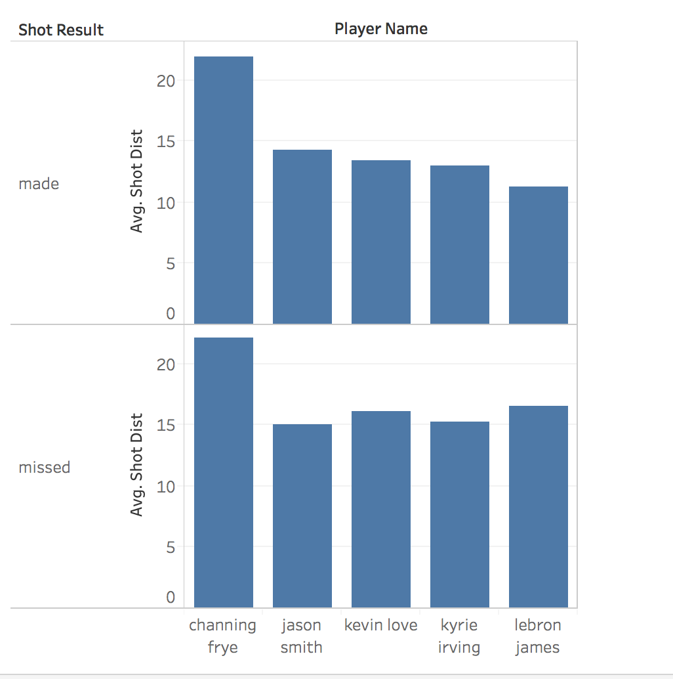
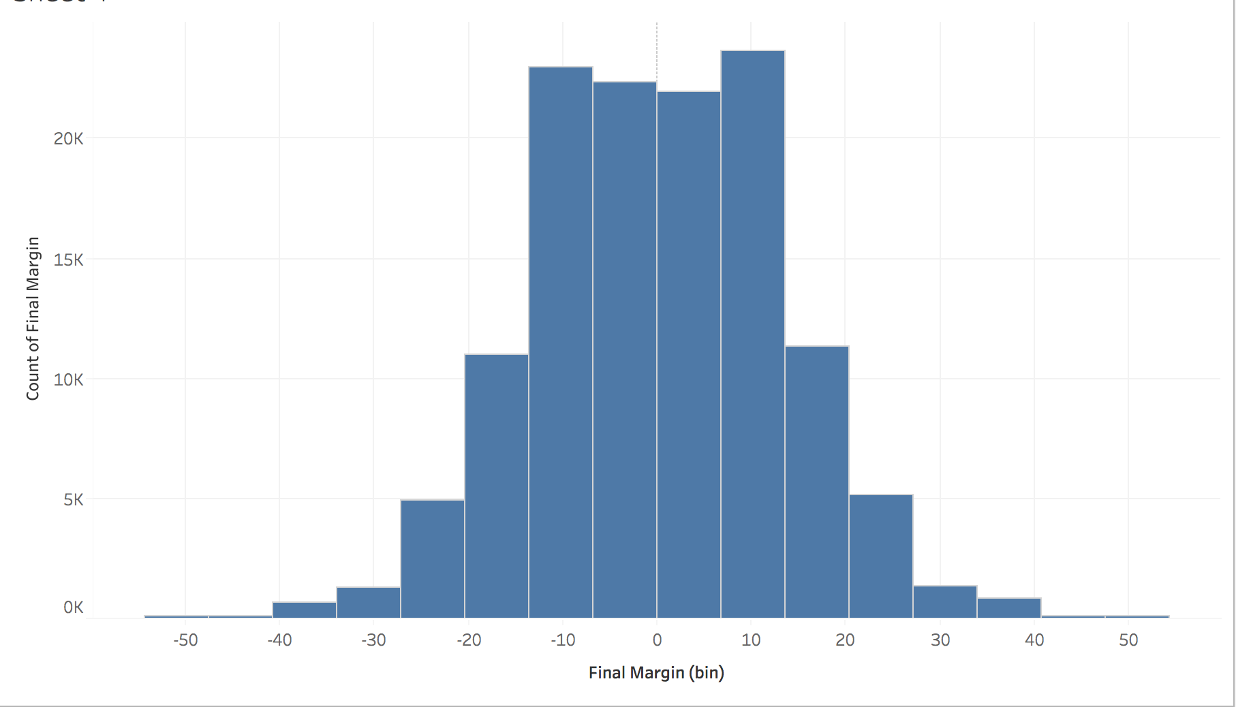
Visualization

Slide 11
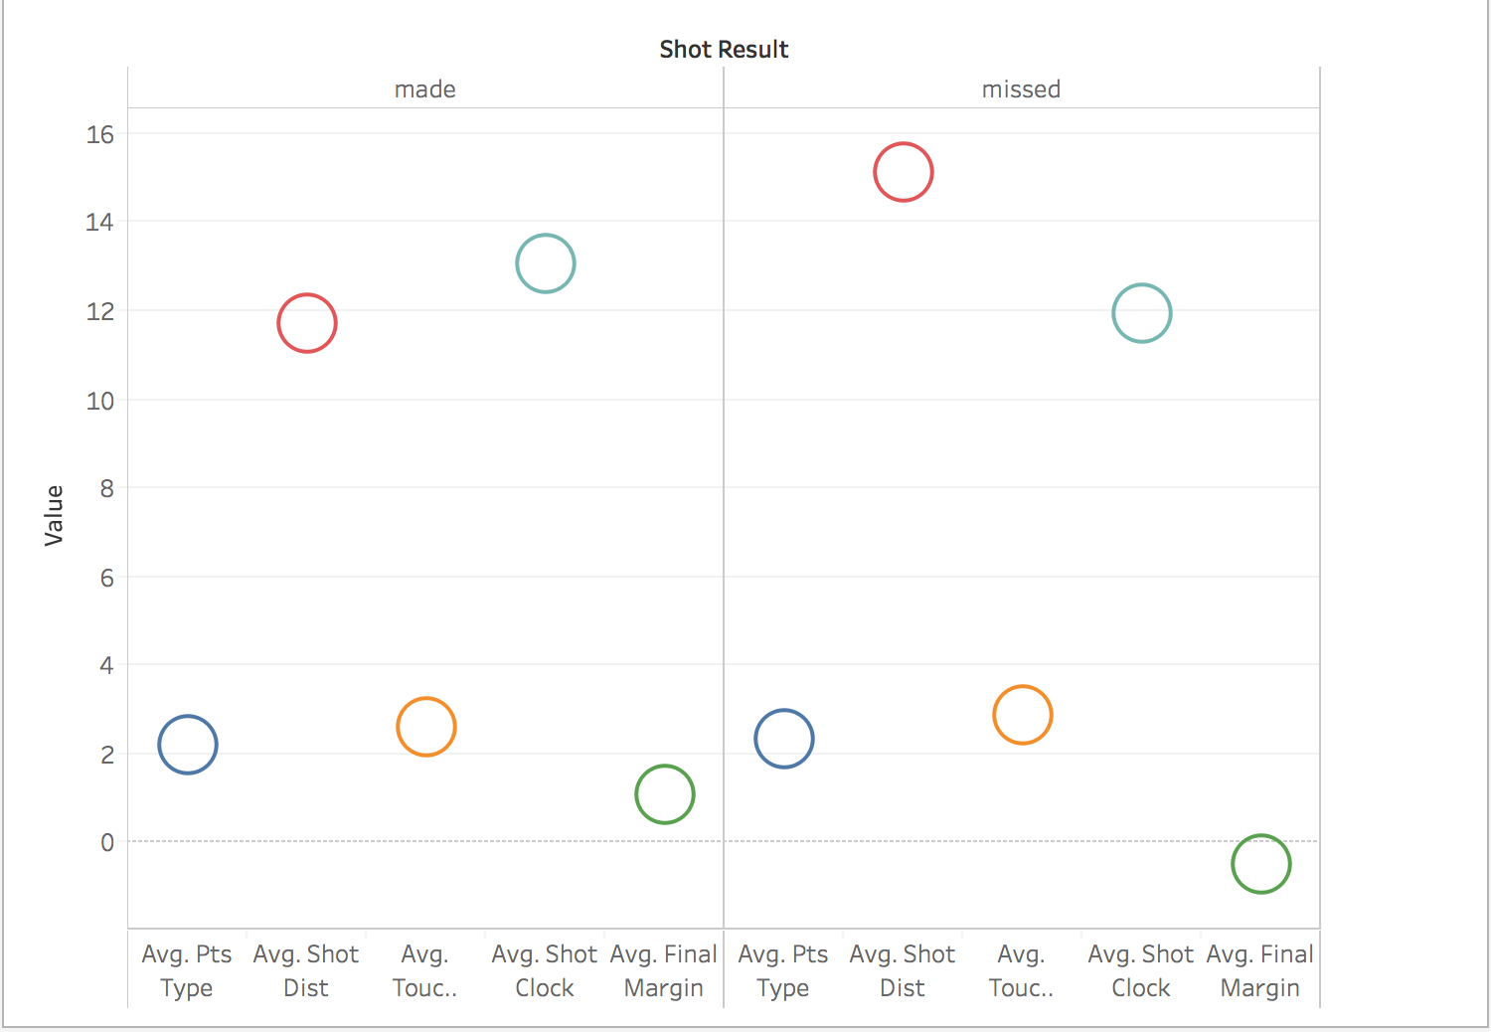

Slide 12
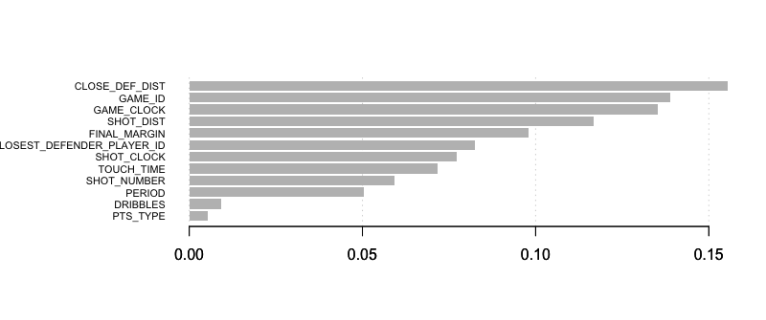
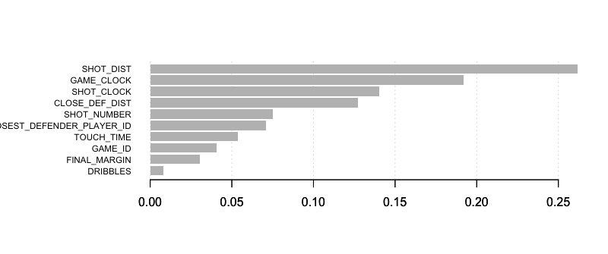
Variable Analysis Visualization
The model built a different characteristic for each player
Frye’s Model
Lebron’s Model

Slide 13
Future Work
Build a model better suited to missing values
Predict for more teams
Use the data to predict expected point totals
There’s a lot to be used

